Slide 1

Tabletop exercise
Joakim Kävrestad Jönköping School of Engineering joakim.kavrestad@ju.se
© Crown Copyright, The National Cyber Security Centre 2023. This information is licensed under the Open Government Licence v3.0. To view this licence, visit https://www.nationalarchives.gov.uk/doc/open-government-licence/version/3/.
When you use this information under the Open Government Licence, you should include the following attribution: CyBOK incident response tabletop exercise slides © Crown Copyright, The National Cyber Security Centre 2023, licensed under the Open Government Licence: https://www.nationalarchives.gov.uk/doc/open-government-licence/version/3/.

Slide 2
Create groups
Divide yourself into groups of 4-5 people
Assign roles so that you have one of each:
CEO
IT-Manager
Legal advisor
Communications manager (one internal and one external if you are five people)

Slide 3
The game
You are the crisis group for the company Economistas
You will soon see an event
Your task is to come up with a response to that event
Document your response on the response card
Give it to me
You will then get a follow-up event which you are to respond to using another response card
Then another event and so on

Slide 4
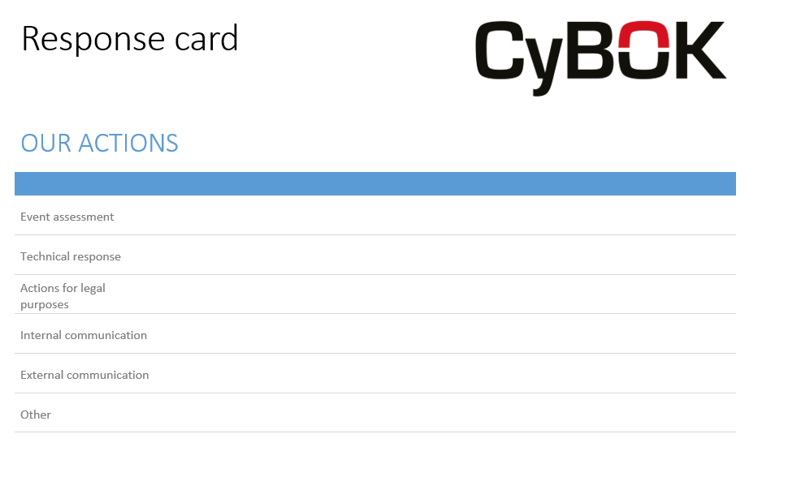
Response cards

Slide 5
A few rules
You are responsible for the areas reasonable for your role
The CEO always has the final say
The CEO delivers the response cards
You can make reasonable assumptions about the infrastructure at Economistas (and use reasonable tech in your responses)
If you need company information, ask the game leader

Slide 6
Let’s play!

